Slide 1

Study-Buddy
By Andrew, Derek, Angel

Slide 2




What does the Study-Buddy solve?
You don’t have to study alone
You can study with students that are taking the same class or have already taken the class
Find study buddies that match your classes and personality
Improve work output by building a commitment to work and study with others

Slide 3
How does it personally improve ourselves
Allow us to find collaborative help on homework
Possibly form new friendships
Promote soft-skills like responsibility, communication, accountability, etc.
Friendship
Collaboration
Ethics
Responsibility
Communication
Accountability

Slide 4
Market Potential
Student are hungry to find groups that are dedicated to classes they are taking.
Society is more dependent to technology than ever before.
These factors make an app that connects people on the basis of creating study groups more in demand than ever
Some students are shy and need a boost to start connecting with people; this app's purpose is to be the medium to which this student starts their study group, and perhaps life-long relationships.

Slide 5

How does study buddy work?
Download our app
Make an account
Set up your profile( Subject(s) you like, Subject(s) you dislike, Subject(s) you’ve taken, Subject(s) you are taking
Post that you are looking for a student group or join a student group
Meet up with your study buddies!!

Slide 6



Our competition
Who are our competitors?
Discord, Teams, Groupme.
Our competitors are too general on their services (play, work, hangout, etc).
They aren’t specialized studying.
A site fully and solely dedicated to studying with peers that are taking/have taken the same class as you is vital as a university/college student.
Why us?
Study-Buddy ensures an environment dedicated fully to studying
We'll link you with groups in your campus that are working in the same topic.
Prioritize groups at your campus, so you can get more involved in the university/college experience.

Slide 7
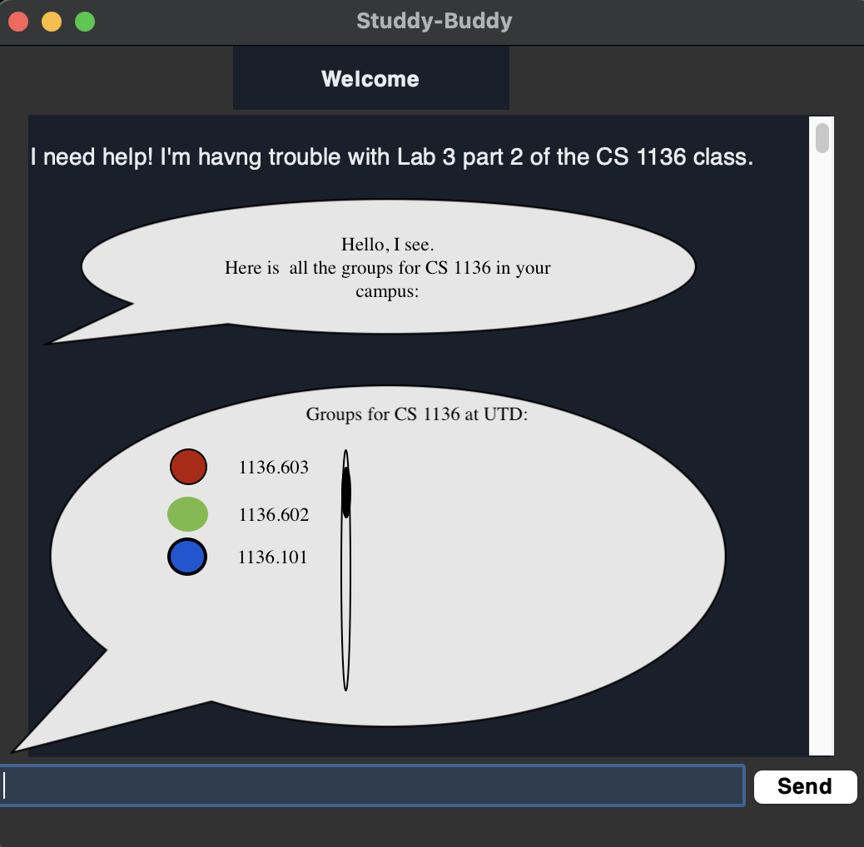
Demonstration
An example of the possible interaction in our Study-Buddy application
A small prototype compared to our actual goals

Slide 8

Here to serve and help higher education students connect and study.

